Slide 1

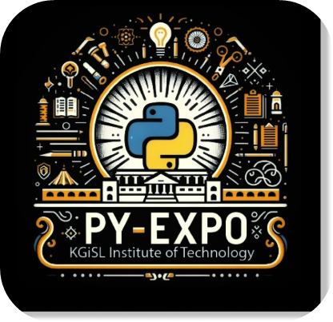




PYEXPO25
Genius innovation leaves behind a legacy...
Team ID: T010
Team Name: Tech Titansgi:stered in portal):
PS Number: PY068
PS Title: AI-Based Exam Proctoring System
Domain: Computer Vision
Category: Software
PYEXPO 2025
IPS TECH COMMUNITY

Slide 2

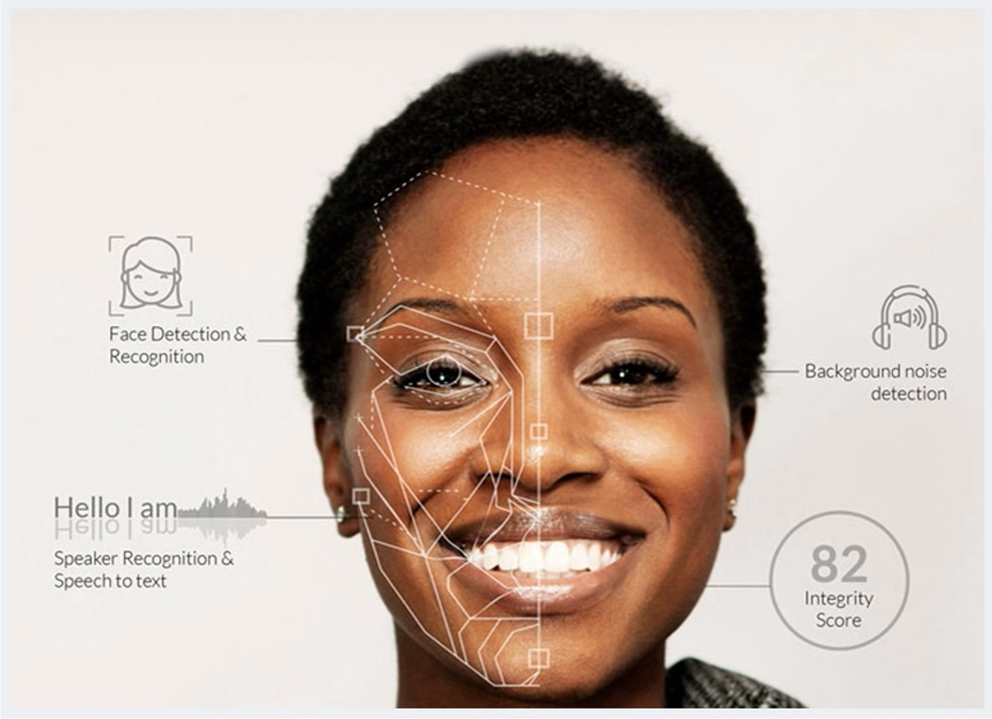
Problem Statement:
What problem are you solving?
AI-BASED EXAM PROCTORING SYSTEM
This project aims to create a app that monitors students during online exams using computer vision and natural language processing (NLP).
It will watch for suspicious behaviors like looking away from the screen,multiple faces or background noise and check for plagiarism in text. The app will log any violations and provide a detailed report for teachers to ensure fairness in exams.
Who is your target audience?
Students are targeted audience.
PYEXPO 2025
IPS TECH COMMUNITY

Slide 3
Proposed Solution and overview:
How does your AI/ML solution address the problem?
The problem of ensuring fairness and integrity in online exams can be solved by using advanced technologies like computer vision and natural language processing(NPL).
The innovation monitor both physical and textual aspects of the exam.
Its uniqueness comes from providing a comprehensive solution that not only ensures a student's physical behavior is honest and the originality of their written answers, creating a more robust and fair online examination process.
Briefly mention the AI/ML model or approach used.
PYEXPO 2025
IPS TECH COMMUNITY
LOGIN

Slide 4
Data And Model :
Data Sources: Where is the data from?
Model: Briefly describe the model (e.g., regression, classification, transformers).
Highlight preprocessing, training methods, or tools (e.g., PyTorch, TensorFlow).
TECHNOLOGIES
1.COMPUTER VISION FOR BEHAVIOR:
OpenCV,Mediapipe,PyTorch,Dlib
2.MULTI-FACE DETECTION:
MediaPipe Face Detection API
3.BACKGROUND NOISE DETECTION:
Pyaudio,Speech recognition,FFT
4.LOGGING AND REPORTING:
SQLite,Pandas,Matplotlib,ReportLab
PYEXPO 2025
IPS TECH COMMUNITY

Slide 5
Result & Evaluation:
Show performance metrics (e.g., accuracy, F1-score, ROC curve).
Visualizations (e.g., confusion matrix, graphs) to back your claims.
PYEXPO 2025
IPS TECH COMMUNITY

Slide 6
Impact and Benefits:
Potential impact on the target audience
Saves time and effort for educators by automating proctoring, allowing them to focus on teaching. .
Benefits of the solution (social, economic, environmental, etc.)
Minimizes the need for physical exam centers, lowering carbon footprints associated with travel and resource consumption.
Ethical Considerations & Real-world Applications:
Address any biases or limitations in the model.
ensuring accuracy in detecting suspicious behavior, and managing large amounts of data for reporting and scaling.
Where can this solution be implemented? (e.g., healthcare, education, retail)
online standardized tests, corporate training programs, remote learning platforms.
PYEXPO 2025
IPS TECH COMMUNITY

Slide 7
Team Member Details:
Name Roll No Dept SOWMYA(TL) 24UAM153 CSE(AI&ML) RAMYA 24UAM138 CSE(AI&ML) ROSHMITA 24UAM143 CSE(AI&ML) BHAVATHARINI 24UAM111 CSE(AI&ML) SRIMATHI 24UAM158 CSE(AL&ML) NANDHINI 24UAM134 CSE(AL&ML)
PYEXPO 2025
IPS TECH COMMUNITY

Slide 8
THANK YOU !

